Slide 1
Because you do not have enough to study yet

Slide 2
STEMI
https://lifeinthefastlane.com/ecg-library/st-segment/
Mean electrical axis
https://en.wikipedia.org/wiki/Einthoven%27s_triangle
http://courses.kcumb.edu/physio/ecg%20primer/ecgaxis.htm

Slide 3
Blood pressure balance
Regulation… discussion
- list various endocrine means
- list various cardiovascular ways

Slide 4
Glucose regulation
Hormones
How to raise blood glucose
- Dawn Phenomenon and the Somogyi Effect - Overview
https://www.webmd.com/diabetes/tc/dawn-phenomenon-and-the-somogyi-effect-
How to lower blood glucose
https://en.wikipedia.org/wiki/Insulin

Slide 5
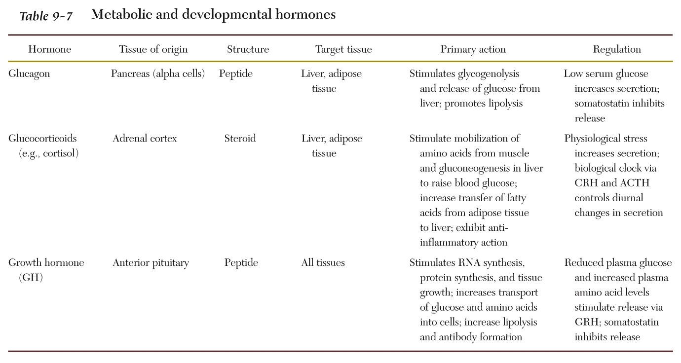

Slide 6
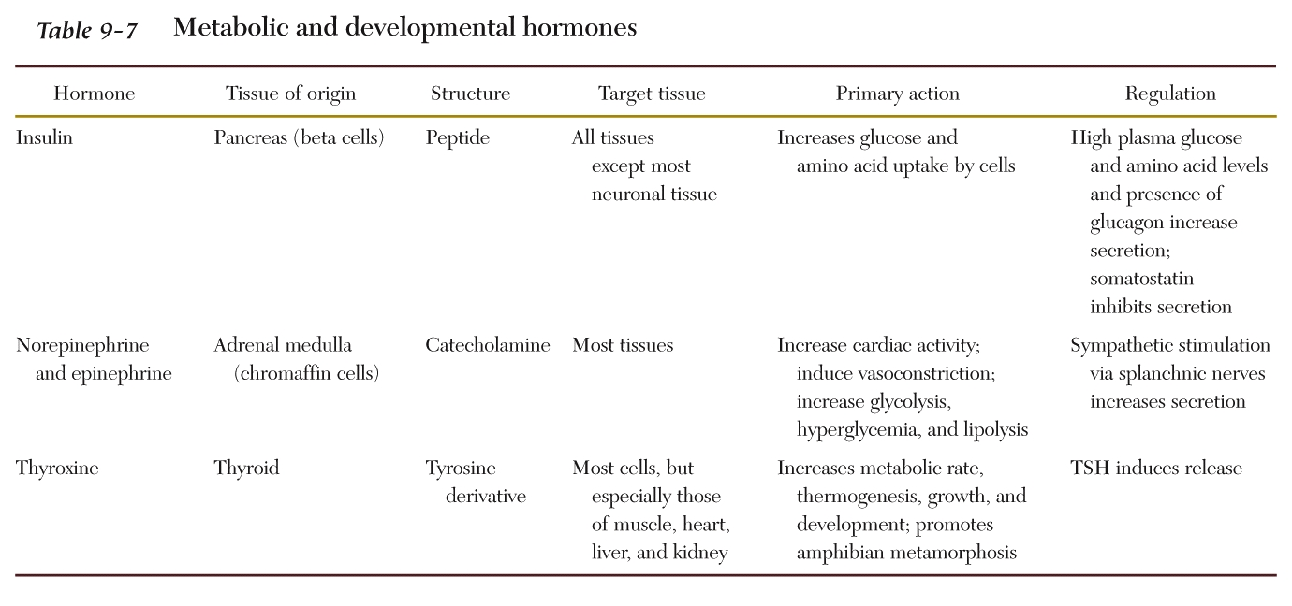

Slide 7
Types of Insulin
http://www.joslin.org/info/insulin_a_to_z_a_guide_on_different_types_of_insulin.html

Slide 8
Metabolic syndrome
https://en.wikipedia.org/wiki/Metabolic_syndrome
https://www.nhlbi.nih.gov/health-topics/metabolic-syndrome

Slide 9
Opposite Sex Twin Pairs ?
Female fetuses developing without adjacent males, on the other hand, tend to show more feminized traits as adults

Slide 10
Fertility Hormone Injections
-Which hormones ?
https://www.uofmhealth.org/health-library/tn9637

Slide 11
https://www.proprofs.com/flashcards/quizshow.php?title=endocrine-system_35
“flash cards endocrine” in google

Slide 12
Fun stuff
https://www.sciencedirect.com/journal/brain-and-development/vol/40/issue/5?dgcid=raven_sd_via_email

